Slide 1

The Halogens
By Tom
AND
Chris

Slide 2
The Halogens
The halogens are a group of non- metals in the periodic table
They all have seven electrons in their outer shell this makes them all really reactive; they only have to gain one more electron to fill their outer shell.
Unlike Group One the elements get less reactive as you go down the group

Slide 3
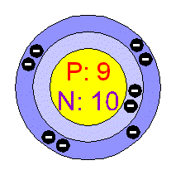
Fluorine (F) 2,7
Name: Fluorine
Symbol: F
Atomic Number: 9
Atomic Mass: 18.998404 amu
Melting Point: -219.62 °C
Boiling Point: -188.14 °C
Number of Protons/Electrons: 9
Number of Neutrons: 10
Colour: Greenish

Slide 4
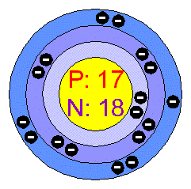
Chlorine (Cl) 2,8,7
Name: Chlorine
Symbol: Cl
Atomic Number: 17
Atomic Mass: 35.4527 amu
Melting Point: -100.98 °C
Boiling Point: -34.6 °C
Number of Protons/Electrons: 17
Number of Neutrons: 18
Colour: green

Slide 5
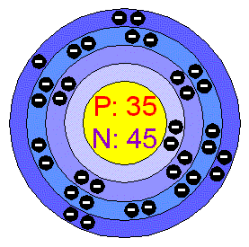
Bromine (Br) 2,8,18,7
Name: Bromine
Symbol: Br
Atomic Number: 35
Atomic Mass: 79.904 amu
Melting Point: -7.2 °C
Boiling Point: 58.78 °C
Number of Protons/Electrons: 35
Number of Neutrons: 45
Colour: Red

Slide 6
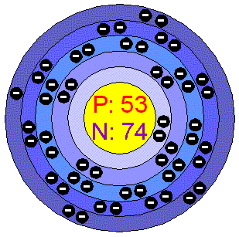
Iodine (I) 2,8,18,18,7
Name: Iodine
Symbol: I
Atomic Number: 53
Atomic Mass: 126.90447 amu
Melting Point: 113.5 °C
Boiling Point: 184.0 °C
Number of Protons/Electrons: 53
Number of Neutrons: 74
Colour: blackish

Slide 7
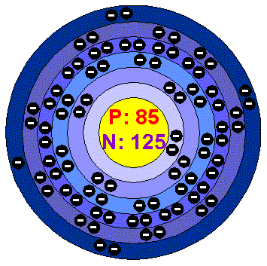
Astatine (At) 2,8,18,32,18,7
Name: Astatine
Symbol: At
Atomic Number: 85
Atomic Mass: (210.0) amu
Melting Point: 302.0 °C
Boiling Point: 337.0 °C
Number of Protons/Electrons: 85
Number of Neutrons: 125
Colour: Unknown

Slide 8

Uses of Fluorine
The main use of fluorine is toothpaste even though it isn’t as fluorine itself but instead as fluoride, a compound of fluorine.

Slide 9
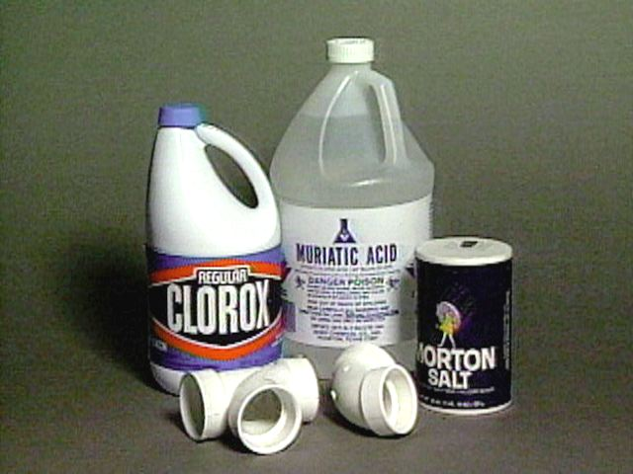
Uses of Chlorine
Chlorine is used mostly to kill bacteria or as a bleach. Chlorine bleaches a piece of universal indicator paper white.

Slide 10

Uses of Bromine
Bromine is one of the main ingredients in camera films (as silver bromide).

Slide 11
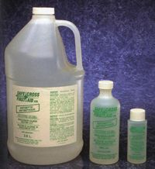
Uses of Iodine
When dissolved in water, iodine can be used as a strong antiseptic or as a test for starch.

Slide 12
Thank you for watching !

Slide 13
This powerpoint was kindly donated to www.worldofteaching.com
http://www.worldofteaching.com is home to over a thousand powerpoints submitted by teachers. This is a completely free site and requires no registration. Please visit and I hope it will help in your teaching.

